Slide 1
Splunk 101
Getting Started with Splunk on AWS
Kam Amir | Splunk Cloud Architect
kam@splunk.com
November 28, 2018 | AWS re:Invent 2018

Slide 3
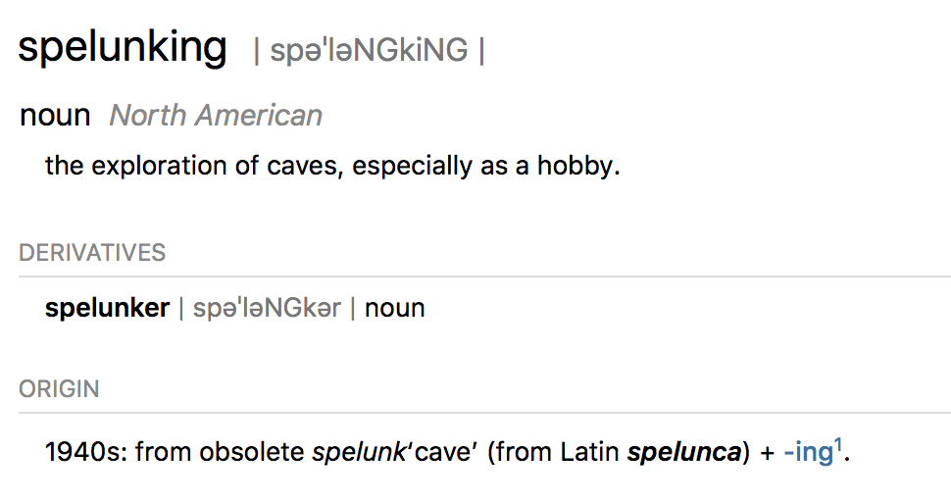
Splunk, that’s a funny name
From Spelunking to “Splunking”

Slide 4
What is Machine Data?

Slide 5
What Does Machine Data Look Like?
SOURCES
Order Processing
ORDER, 2016-05-21T14:04:12.484,10098213,569281734,67.17.10.12,43CD1A7B8322,SA-2100
MAY 21 14:04:12.996 wl-01.acme.com Order 569281734 failed for customer 10098213.
Exception follows: weblogic.jdbc.extensions.ConnectionDeadSQLException:
weblogic.common.resourcepool.ResourceDeadException: Could not create pool connection. The
DBMS driver exception was: [BEA][Oracle JDBC Driver] Error establishing socket to host and port:
ACMEDB-01:1521. Reason: Connection refused
05/21 16:33:11.238 [CONNEVENT] Ext 1207130 (0192033): Event 20111, CTI Num:ServID:Type
0:19:9, App 0, ANI T7998#1, DNIS 5555685981, SerID 40489a07-7f6e-4251-801a-
13ae51a6d092, Trunk T451.16
05/21 16:33:11:242 [SCREENPOPEVENT] SerID 40489a07-7f6e-4251-801a-13ae51a6d092
CUSTID 10098213
05/21 16:37:49.732 [DISCEVENT] SerID 40489a07-7f6e-4251-801a-13ae51a6d092
{actor:{displayName: “Go Boys!!”,followersCount:1366,friendsCount:789,link:
http://dallascowboys.com/,location:{displayName:“Dallas, TX”,objectType:“place”},
objectType:“person”,preferredUsername:“B0ysF@n80”,statusesCount:6072},body: “Can’t buy
this device from @ACME. Site doesn’t work! Called, gave up on waiting for them to answer! RT if
you hate @ACME!!”,objectType:“activity”,postedTime:“2016-05-21T16:39:40.647-0600”}
Middleware Error
Care IVR
Twitter
Notes:
Unlike traditional structured data or multi-dimensional data– for example data stored in a traditional relational database for batch reporting – machine data is non-standard, highly diverse, dynamic and high volume. You will notice that machine data events are also typically time-stamped – it is time-series data.
Take the example of purchasing a product on your tablet or smartphone: the purchase transaction fails, you call the call center and then tweet about your experience. All these events are captured - as they occur - in the machine data generated by the different systems supporting these different interactions.
Each of the underlying systems can generate millions of machine data events daily. Here we see small excerpts from just some of them.

Slide 6
Machine Data Contains Critical Insights
SOURCES
Customer ID
Order ID
Product ID
Order Processing
ORDER, 2016-05-21T14:04:12.484,10098213,569281734,67.17.10.12,43CD1A7B8322,SA-2100
MAY 21 14:04:12.996 wl-01.acme.com Order 569281734 failed for customer 10098213.
Exception follows: weblogic.jdbc.extensions.ConnectionDeadSQLException:
weblogic.common.resourcepool.ResourceDeadException: Could not create pool connection. The
DBMS driver exception was: [BEA][Oracle JDBC Driver] Error establishing socket to host and port:
ACMEDB-01:1521. Reason: Connection refused
05/21 16:33:11.238 [CONNEVENT] Ext 1207130 (0192033): Event 20111, CTI Num:ServID:Type
0:19:9, App 0, ANI T7998#1, DNIS 5555685981, SerID 40489a07-7f6e-4251-801a-
13ae51a6d092, Trunk T451.16
05/21 16:33:11:242 [SCREENPOPEVENT] SerID 40489a07-7f6e-4251-801a-13ae51a6d092
CUSTID 10098213
05/21 16:37:49.732 [DISCEVENT] SerID 40489a07-7f6e-4251-801a-13ae51a6d092
{actor:{displayName: “Go Boys!!”,followersCount:1366,friendsCount:789,link:
http://dallascowboys.com/,location:{displayName:“Dallas, TX”,objectType:“place”},
objectType:“person”,preferredUsername:“B0ysF@n80”,statusesCount:6072},body: “Can’t buy
this device from @ACME. Site doesn’t work! Called, gave up on waiting for them to answer! RT if
you hate @ACME!!”,objectType:“activity”,postedTime:“2016-05-21T16:39:40.647-0600”}
Order ID
Customer ID
Middleware Error
Time waiting on hold
Care IVR
Customer ID
Twitter ID
Customers Tweet
Twitter
Company’s Twitter ID
Notes:
When we look more closely at the data we see that it contains valuable information – citizen id, case id, time waiting on hold, twitter id … what was tweeted.
What’s important is first of all the ability to actually see across all these disparate data sources, but then to correlate related events across disparate sources, to deliver meaningful insight.

Slide 7
Machine Data Contains Critical Insights
SOURCES
Customer ID
Order ID
Product ID
Order Processing
ORDER, 2016-05-21T14:04:12.484,10098213,569281734,67.17.10.12,43CD1A7B8322,SA-2100
MAY 21 14:04:12.996 wl-01.acme.com Order 569281734 failed for customer 10098213.
Exception follows: weblogic.jdbc.extensions.ConnectionDeadSQLException:
weblogic.common.resourcepool.ResourceDeadException: Could not create pool connection. The
DBMS driver exception was: [BEA][Oracle JDBC Driver] Error establishing socket to host and port:
ACMEDB-01:1521. Reason: Connection refused
05/21 16:33:11.238 [CONNEVENT] Ext 1207130 (0192033): Event 20111, CTI Num:ServID:Type
0:19:9, App 0, ANI T7998#1, DNIS 5555685981, SerID 40489a07-7f6e-4251-801a-
13ae51a6d092, Trunk T451.16
05/21 16:33:11:242 [SCREENPOPEVENT] SerID 40489a07-7f6e-4251-801a-13ae51a6d092
CUSTID 10098213
05/21 16:37:49.732 [DISCEVENT] SerID 40489a07-7f6e-4251-801a-13ae51a6d092
{actor:{displayName: “Go Boys!!”,followersCount:1366,friendsCount:789,link:
http://dallascowboys.com/,location:{displayName:“Dallas, TX”,objectType:“place”},
objectType:“person”,preferredUsername:“B0ysF@n80”,statusesCount:6072},body: “Can’t buy
this device from @ACME. Site doesn’t work! Called, gave up on waiting for them to answer! RT if
you hate @ACME!!”,objectType:“activity”,postedTime:“2016-05-21T16:39:40.647-0600”}
Order ID
Customer ID
Middleware Error
Time waiting on hold
Care IVR
Customer ID
Twitter ID
Customers Tweet
Twitter
Company’s Twitter ID
Notes:
If you can correlate and visualize related events across these disparate sources, you can build a picture of activity, behavior and experience. And what if you can do all of this in real-time? You can respond more quickly to events that matter.
For example, if an organizations captured the customers twitter ID in their customer profile this correlation would be possible. Where that didn’t exist, they could at least group by demographic with the tweets.
You can extrapolate this example to a wide range of use cases – security and fraud, transaction monitoring and analysis, web analytics, IT operations and so on.

Slide 8
Why Splunk?

Slide 10








Bring the Data, Solve Use Cases
Index Untapped Data: Any Source, Type, Volume
End-to-End Visibility
Online Services
Application Delivery
Containers
On-Premises
Web Services
IT Operations
Servers
Security
GPS Location
Config
Networks
Security, Compliance
and Fraud
Storage
RDS
Messaging
Private Cloud
Energy Meters
EC2
RFID
Business Analytics
Telecoms
EMR
Call Detail Records
Databases
CloudTrail
Internet of Things
and Industrial Data
Public Cloud
Web Clickstreams
Lambda

Slide 11
Splunk Apps

Slide 12












The Splunk Portfolio
Splunk Premium Solutions
Rich Ecosystem of Apps & Add-Ons
Platform for Operational Intelligence
Forwarders
Syslog/ TCP
Mobile
IoT Devices
Network Wire Data
Hadoop
Relational Databases
Mainframe
Data
Notes:
Splunk has several applications and partnerships that make us especially relevant for the Internet of Things:
Community apps such as modular inputs for REST Endpoints, Kinesis, Kafka, and JMS Messaging Services allow easy connection to and ingestion of the high velocity and volume data available from the web services and from web based messaging queues that are becoming so common in IoT data delivery. Splunk’s DB Connect allows connection to data stored in relational databases, as well as to traditional structured metadata sources which can be used for Splunk lookups. And for the makers in the house, a community supported Splunk Universal Forwarder for ARM architectures runs on platforms like Raspberry Pi for easy access to the data and applications running on those IoT devices.
Strong partnerships with companies well established in the internet of things, including Kepware, CQCloud and DataFlare for industrial data collection, analytics and visualization, and ThingWorx and MachineShop for IoT platforms integration in the Enterprise.

Slide 13

End State: Comprehensive AWS Visibility
https://www.splunk.com/en_us/partners/solutions/aws/data-insights-tool.html
Notes:
Splunk provides comprehensive visibility for your AWS environment, allowing you to easily search, analyze, correlate, visualize, and act on your data.

Slide 14
Splunk App for AWS: The Value
Usage
Security
Billing
View EC2 utilization metrics
View by account, region, instance
Supports numerous AWS services
View user activity
Gain a full audit trail
Detect anomalous behavior
Gain view into resource cost
Improve RI planning / utilization
Monitor actual spend vs. forecast
Topology
Timeline
Insights
Visualize your AWS Environment
View resource relationships
Gain playback history
Compare and correlate events
View in a time-series ribbon
Accelerate investigations
Leverage machine learning toolkit
Gain billing recommendations
Detect security and billing anomalies

Slide 15
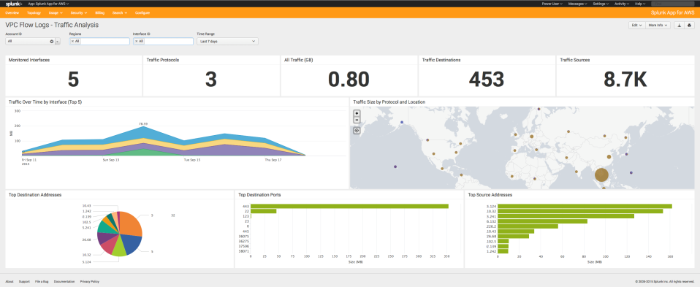
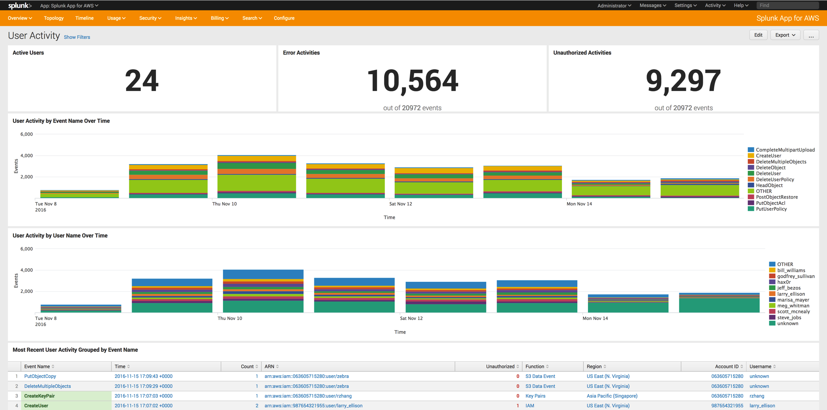
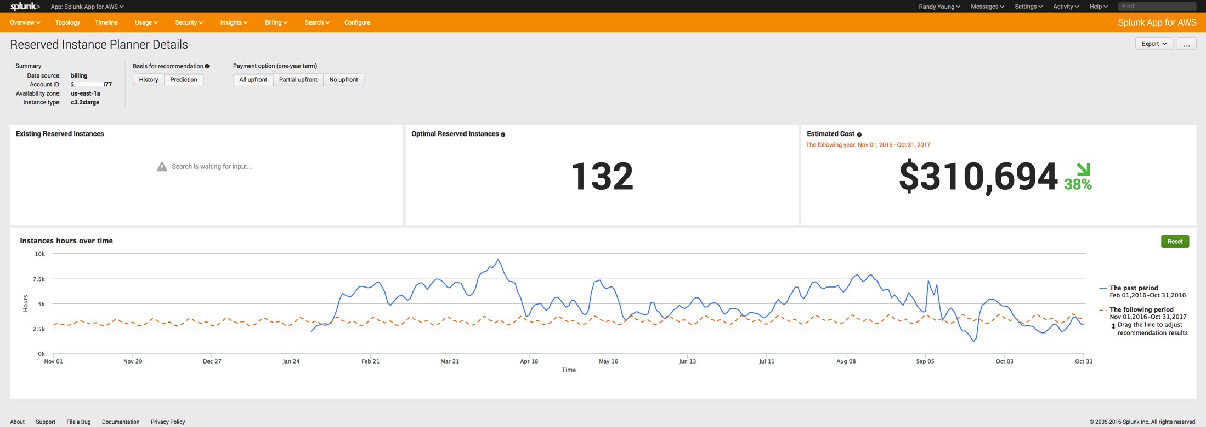
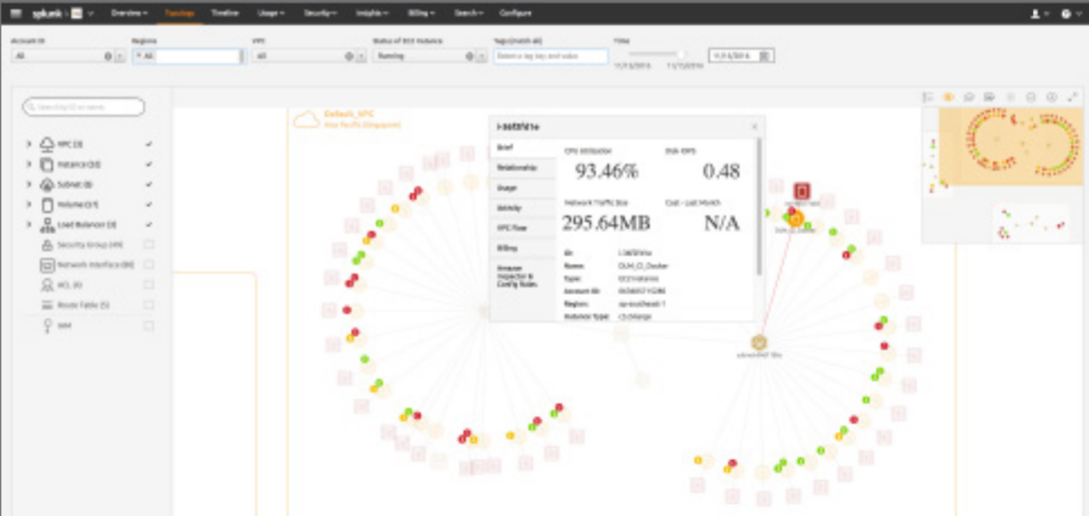
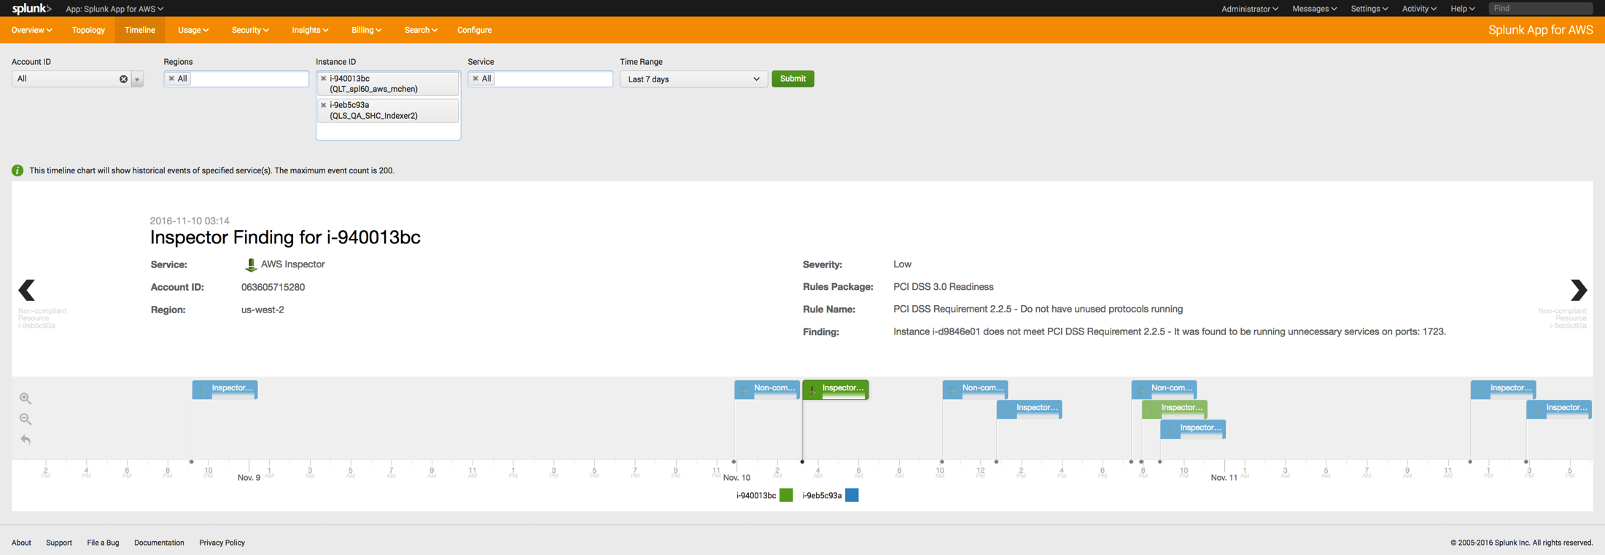
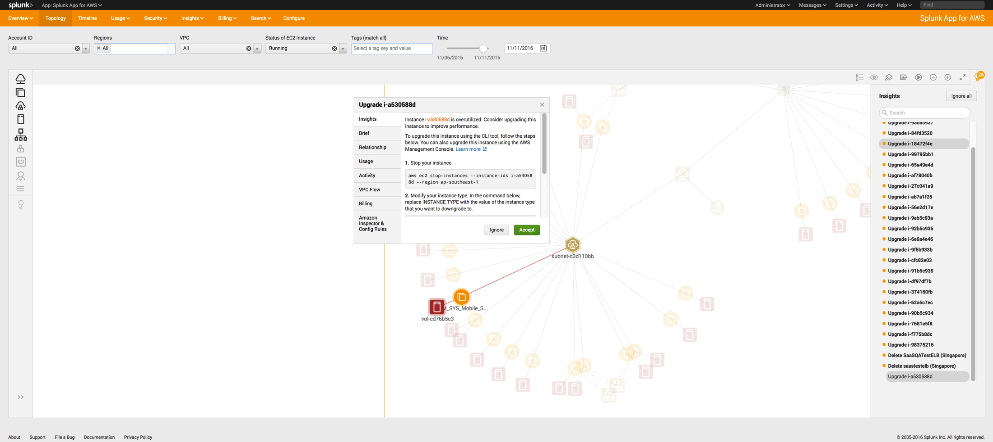
Splunk App for AWS: The Value
Usage
Security
Billing
View EC2 utilization metrics
View by account, region, instance
Supports numerous AWS services
View user activity
Gain a full audit trail
Detect anomalous behavior
Gain view into resource cost
Improve RI planning / utilization
Monitor actual spend vs. forecast
Topology
Timeline
Insights
Visualize your AWS Environment
View resource relationships
Gain playback history
Compare and correlate events
View in a time-series ribbon
Accelerate investigations
Leverage machine learning toolkit
Gain billing recommendations
Detect security and billing anomalies

Slide 16










Kinesis Firehose With Splunk Delivery
Ingest
Transform
Deliver
Kinesis Agent
Amazon S3
Kinesis Streams
Amazon Redshift
CloudWatch Logs
Amazon Elasticsearch
CloudWatch Events
AWS IoT

Slide 17
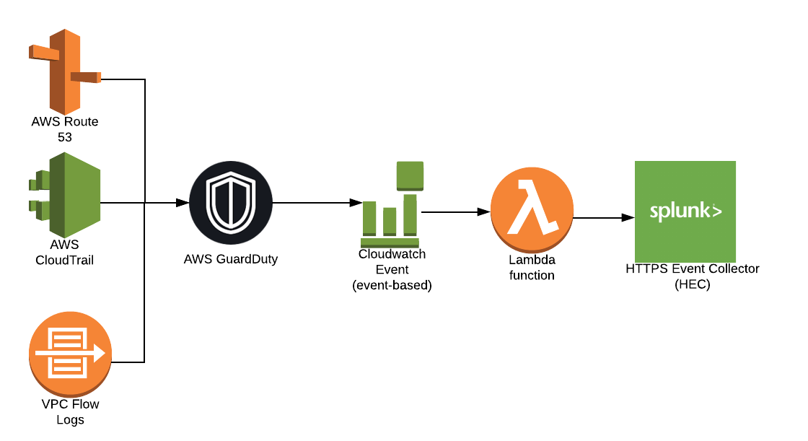
Splunk GuardDuty data flow
AWS GuardDuty analyzes information from Route 53, CloudTrail, and VPC Flow Logs.
AWS Cloudwatch Event triggers a Lambda. Immediately for the first alert, every six hours afterwards.
Lambda function sends CloudWatch data to a Splunk HTTPS Event Collector.
Note: The Splunk Lambda blueprints and video was extremely helpful in getting this configured.

Slide 18

Detailed Use Cases
IT Operations
Security
Cost Management
What is my EBS footprint and posture across all my accounts and all my regions?
Who started/stopped/restarted what instances and when?
What EC2 instances are underutilized and perhaps overprovisioned?
What is the traffic volume into my VPC and where is it originating from?
Why are certain resources unreachable from certain subnets/VPCs?
List resources with missing or non-conforming tags
Who added that rule in the security group that protects our application servers?
Where is the blocked traffic into that VPC coming from?
What was the activity trail of a particular user before and after that incident?
Alert me when a user imports key-pairs or when a security group allows all ports
What instances are provisioned outside of a VPC, by whom and when?
What security groups are defined but not attached to any resource?
How many instances am I running?
What reserved instances have I purchased in the past?
What is my reserved instance utilization?
How much am I paying per account?
How much am I using per service across all accounts?
How many reserved instances should I buy based on usage?
Is this account within budget this month, and how has it tracked in the last year?

Slide 19
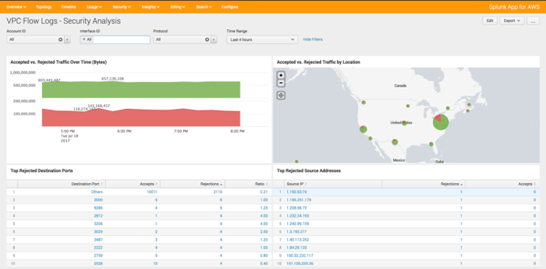
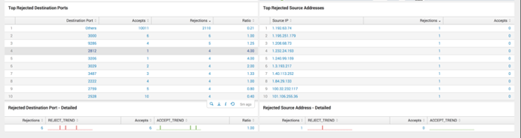
Example investigative methods
Who added that rule in the security group that protects our application servers?
Where is the blocked traffic into that VPC coming from?
What was the activity trail of a particular user before and after an incident?
Alert me when a user imports key-pairs or when a security group allows all ports
What instances are provisioned outside of a VPC, by whom and when?
What security groups are defined but not attached to any resource?
Splunk App for AWS

Slide 20
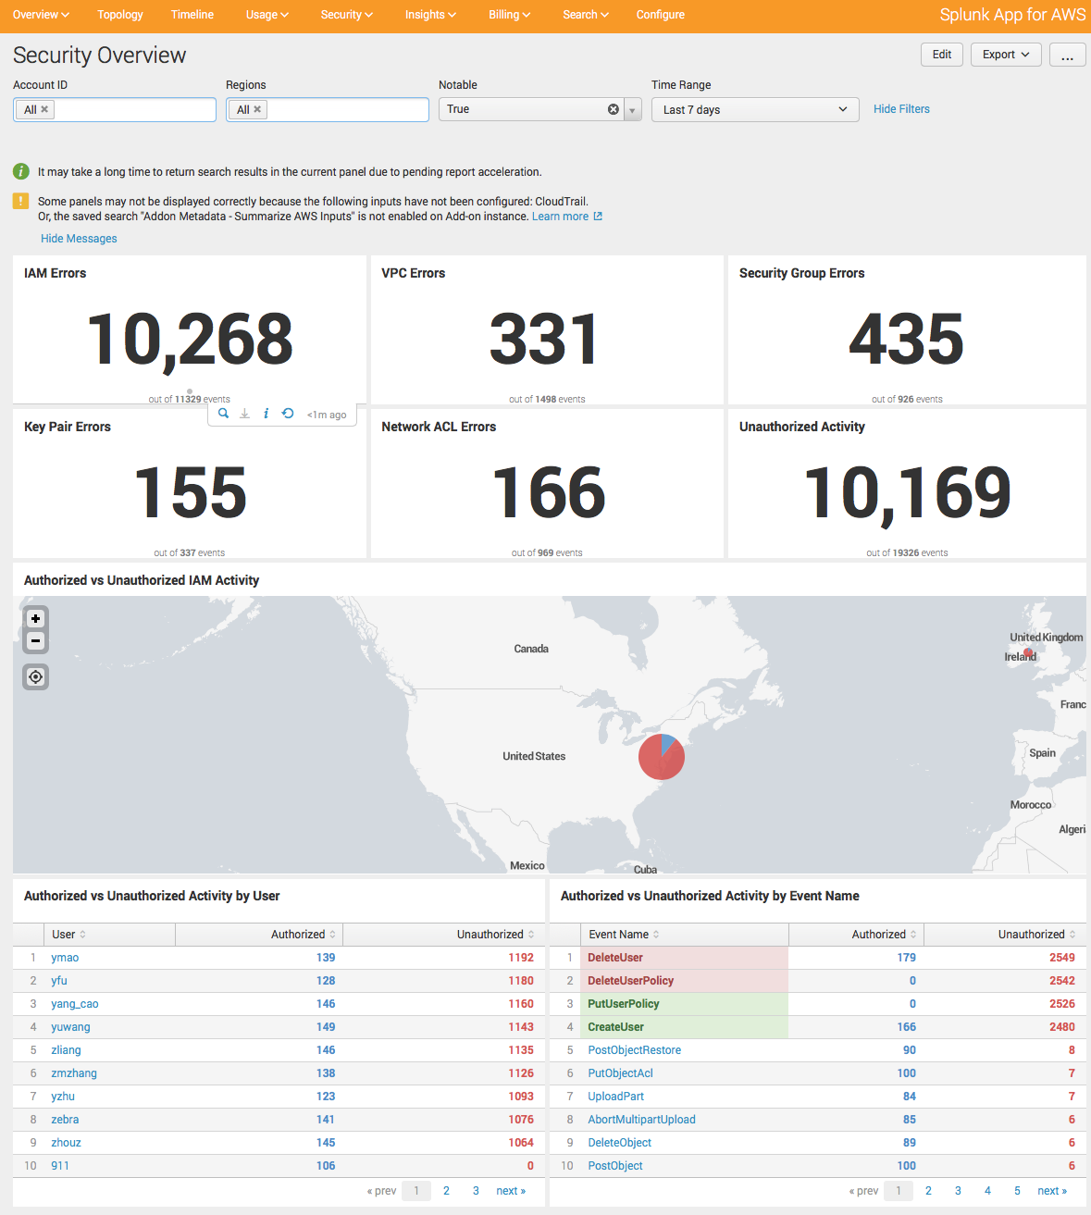
Examples: basic posture methods
Sudden change in the number of security group rules?
Sudden change in the number of ACL modifications?
Spike in error activity caused by unauthorized actions?
Are there any publicly accessible Amazon S3 buckets?
Any provisioning activity from an unusual country?
API calls from users who have not made API calls before?
First time a user provisioned an instance / account / etc.?

Slide 21
Getting Data In from AWS

Slide 22

Getting Data In from AWS
Cooking with Splunk and AWS Workshop
Cooking with AWS and Splunk (Workshop)
https://github.com/amiracle/cooking_with_Splunk_and_AWS
Workshop / lab that informs people of AWS services and how to set them up to send data into Splunk
Lab Guide walks through each step necessary to build Heavy Forwarder (HF) to collect data using the Splunk Add-on for AWS

Slide 23

Getting Data In from AWS
Lambda Functions for CloudWatch Logs Blog
Getting data in from
https://www.splunk.com/blog/2017/02/03/how-to-easily-stream-aws-cloudwatch-logs-to-splunk.html
Blog post that details how to collect CloudWatch Logs using Lambda Functions and sending the data into Splunk via HEC

Slide 24

Getting Data In from AWS
Project Trumpet: Automating AWS Data Collection
Getting data in from
https://www.splunk.com/blog/2018/09/17/automating-aws-data-ingestion-into-splunk.html
Project Trumpet is a Cloud Formation driven solution that will setup AWS accounts and send data serverlessly into Splunk using AWS Kinesis Firehose

Slide 25
Try Splunk on …

Slide 26

Download or as a Service
Delivery Models
Apps and Integrations
SaaS on AWS
DIY with Amazon EC2
Enterprise on AWS
Cloud Services Apps
Splunk App for AWS, ServiceNow, Salesforce, etc.
100% Uptime SLA
SOC2 Type II Certified
Runs on AWS
Splunk Core + Enterprise Security & ITSI available
Insights for AWS
AWS Specific Integrations
CloudTrail, CloudWatch/Logs, Config/Rules, Inspector, Kinesis, S3, VPC Flow Logs, Billing, SQS, SNS
Deploy with AWS Quick Start!
Notes:
~2:00 minutes
Enumerate AWS specific offerings and solutions. Briefly describe each one:
Splunk cloud – SaaS application built on AWS, 100% uptime SLA and it’s SOC 2 certified
Splunk paid AMI coming in July , currently you can get a BYOL in marketplace AMI.
Splunk Insights for AWS
Enterprise Security: This is positioned as a “premium service”
ITSI:
Splunk App for AWS:

Slide 27
Splunk is available in AWS Marketplace
Options for Splunk Cloud & Splunk Enterprise
AWS Marketplace Ease of Sale
Easily discover & deploy software & SaaS
Simplified buying process and consolidated AWS Billing reduces time to procure
Automatic renewals
One consolidated AWS bill
Potential impact and “draw-down” on AWS EDP (Enterprise Discount Program) Contracts
Splunk Specifics
Annual contract subscriptions & automatic discount for multi-annual options
Buy Splunk Cloud in increments of 5GB to 100GB across all supported regions
Easily upgrade Splunk license
Marketplace seller private offers available for larger index volumes, apps and add-ons
Splunk Enterprise licensing available via AWS Marketplace seller private offers
Explore AWS Marketplace
New! Splunk Insights for Infrastructure Pay-as-You-Go

Slide 28
Thanks
Kamilo “Kam” Amir
kam@splunk.com

